Slide 1



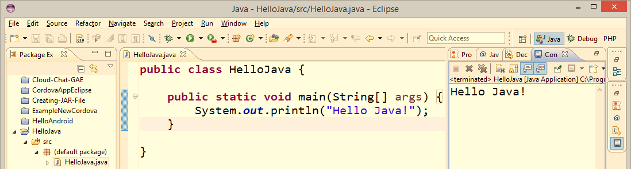
Introduction to Java
The Java Platform, The Java Language, JDK, Eclipse
Svetlin Nakov
Technical Trainer
www.nakov.com
Software University
http://softuni.bg

Slide 2







SoftUni Diamond Partners

Slide 3


Table of Contents
Your First Java Program
The Java Language
The Java Platform and JVM
JDK – Java SE Development Kit
Using javac and java from the command line
Java IDEs
Java Documentation

Slide 4

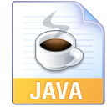
Warning: Not for Absolute Beginners
The "Java Basics" course is NOT for absolute beginners
Take the "C# Basics" course at SoftUni first: https://softuni.bg/courses/csharp-basics
The course is for beginners, but with previous coding skills
Requirements
Coding skills – entry level
Computer English – entry level
Logical thinking
coding skills
required!

Slide 5
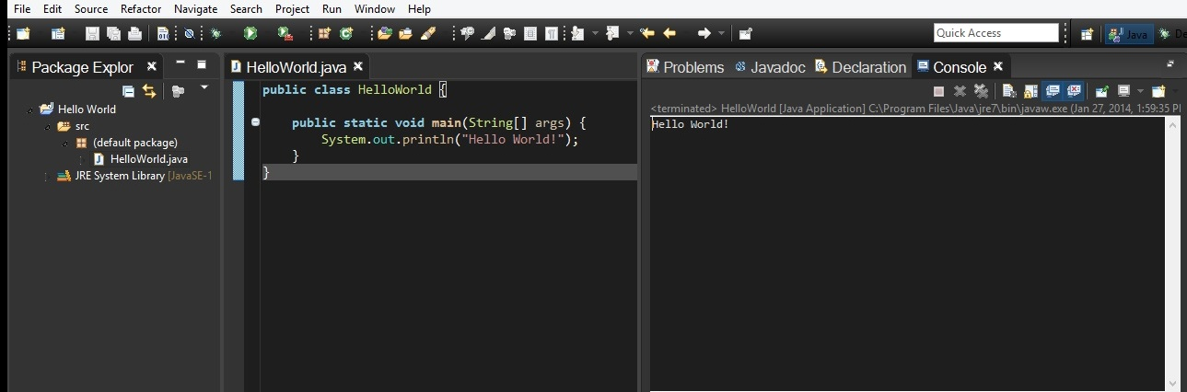
Your First Java Program
Writing and Running Java Code in Eclipse

Slide 6
First Look at Java
A sample Java program:
public class HelloJava {
public static void main(String[] args) {
System.out.println("Hello Java!");
}
}

Slide 7
Java Code – How It Works?
Define a class "HelloJava"
Define the main(…) method – the program entry point
public class HelloJava {
public static void main(String[] args) {
System.out.println("Hello Java!");
}
}
Print a text on the console by calling the method "println" of the class "System"

Slide 8
Formatting Java Code
Class names in Java are in PascalCase.
Method names in Java are in camelCase.
public class HelloJava {
public static void main(String[] args) {
System.out.println("Hello Java!");
}
}
The { symbol stays at the same line.
The } symbol stays under the block holding the {.
The block after the { symbol is indented right by a TAB.

Slide 9
File Names Should Match Class Names!
In Java all public classes should stay in a file with the same name
For example, the class HelloJava should be in the file HelloJava.java
HelloJava.java
public class HelloJava {
public static void main(String args[]) {
System.out.println("Hello Java!");
}
}

Slide 10
Your First Java Program
Live Demo

Slide 11
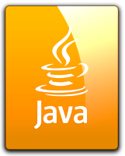
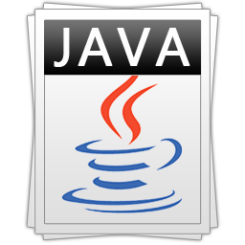
What is "Java"?
Java is very popular programming language
A syntax to describe computer programs
Object-oriented, statically typed, similar to C#
Easy to learn, easy to read, easy to understand
Java is a development platform
Java SE, Java EE, JavaFX, Java ME, Android
Runs compiled Java code in a virtual machine (JVM)
Runs on millions of devices, in any OS

Slide 12
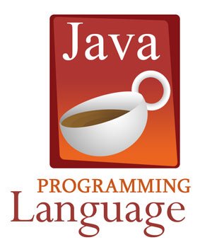
The Java Programming Language

Slide 13
The Java Programming Language
Java programming language
High-level object-oriented general purpose language
Statically typed (not dynamic like JavaScript)
Type-safe (runs in a virtual machine, called JVM)
Easy to learn, easy to read, easy to understand
Good for large server-side projects
Similar to C# and C++, but less capable
Highly portable (write once, run everywhere)

Slide 14
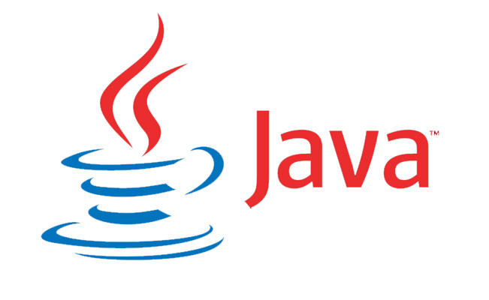
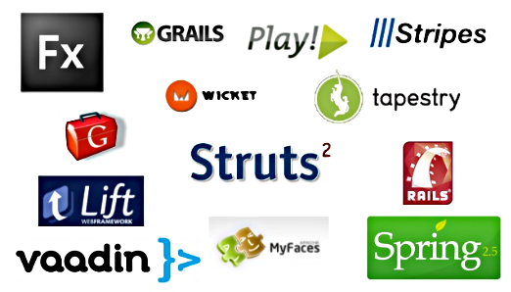

The Java Platform
Java, JVM, JDK

Slide 15
The Java Platform
Environment for execution of Java code
JVM (Java Virtual Machine)
Java programming language
Powerful class library (Java API) and programing model
Ability to run Java programs on any machine with JVM
Windows, Linux, MacOS, Android, your TV, your car, ...
Java Platform Editions
Java SE, Java EE, Android, Java ME, Java Card, Java Embedded, …

Slide 16
The Java Platform – History
Java 1.0a2 (1995) – started as platform for Java applets
JDK 1.0 (1996) – Java language, JDK, JVM, standard API classes
JDK 1.1 (1997) – AWT UI framework, JavaBeans, JDBC
J2SE 1.2 (1998) – J2SE, J2EE, J2ME, Swing UI framework, collections
J2SE 1.3 (2000) – HotSpot JVM, JavaSound, JNDI
J2SE 1.4 (2002) – Java Web Start, JAXP, regular expressions
J2SE 5.0 (2004) – generics, varargs, foreach, autoboxing, enums
Java SE 6 (2006) – GUI improvements, JVM improvements, open-source
Oracle buys Sun (2009) – Java becomes more open
Java SE 7 (2011) – dynamic languages, new I/O, try-with-resources
Java SE 8 (2014) – lambda expressions, streams API, JavaFX UI framework

Slide 17
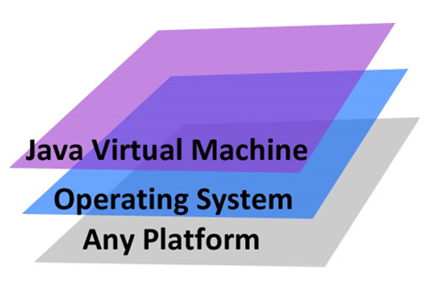
Java Platform: Terminology
JVM – Java Virtual Machine
Executes compiled Java bytecode (compiled programs)
Virtual environment for safe code execution
Similar to CLR in .NET
JRE – Java Runtime Environment
A runtime environment for Java-based software
Similar to .NET Framework
JRE = JVM + Java API classes (standard Java libraries)
Available for Windows, Linux, Mac OS X (no Android and iOS version)

Slide 18
Java Platform: Terminology (2)
JDK – Java Development Kit (Java SDK)
The development platform for Java developers
Consists of JRE (JVM + API classes) + compilers + tools
Available for several OS: Windows, Linux, Mac OS X
Note that Android SDK is not type of JDK (it is separate platform)
Class file (.class file)
A compiled Java code (or Python / Groovy / other language code)
Holds Java bytecode + metadata
Usually multiple class files are packed into a JAR archive

Slide 19
Java Platform: Terminology (2)
JAR archive (.jar files)
JAR archives hold a set of classes and resources
Like the assemblies in .NET Framework (.dll files)
JAR files are ZIP archives with files + manifest (metadata XML)
Classpath
A set of directories and JAR archives holding your application's classes and resources (e.g. images, icons, sounds, etc.)
When loading a class or resource, the JVM traverses the classpath to find the requested classes or files

Slide 20


Java Compilation and Execution
HelloJava.java
HelloJava.class
public class HelloJava {
public static void
main(String args[]) {
System.out.println(
"Hello Java!");
}
}
Compilation (javac)
CAFE BABE 6D61 696E 0100 1628 5B4C 6A61 7661 2F6C 616E 672F 5374 7269 6E67 3B29 5609 0011 0013 0700 1201 0010 6A61 7661 2F6C 616E 672F 5379 7374 656D 0C00 1400 1501 0003 6F75 7401 0015 4C6A 6176 612F 696F 2F50 7269 6E74 5374 7265 616D 3B08 0017 0100 0C48 656C 6C6F 2C20 4A61
(source code)
(bytecode)
Execution (java)
JVM

Slide 21
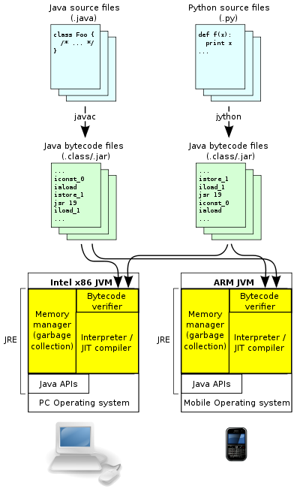
Cross-Platform Java
Cross-platform compilation and execution
Java / Python code → .class / .jar files → execution in the JVM
JVM runs on many devices
Bytecode is portable by nature

Slide 22
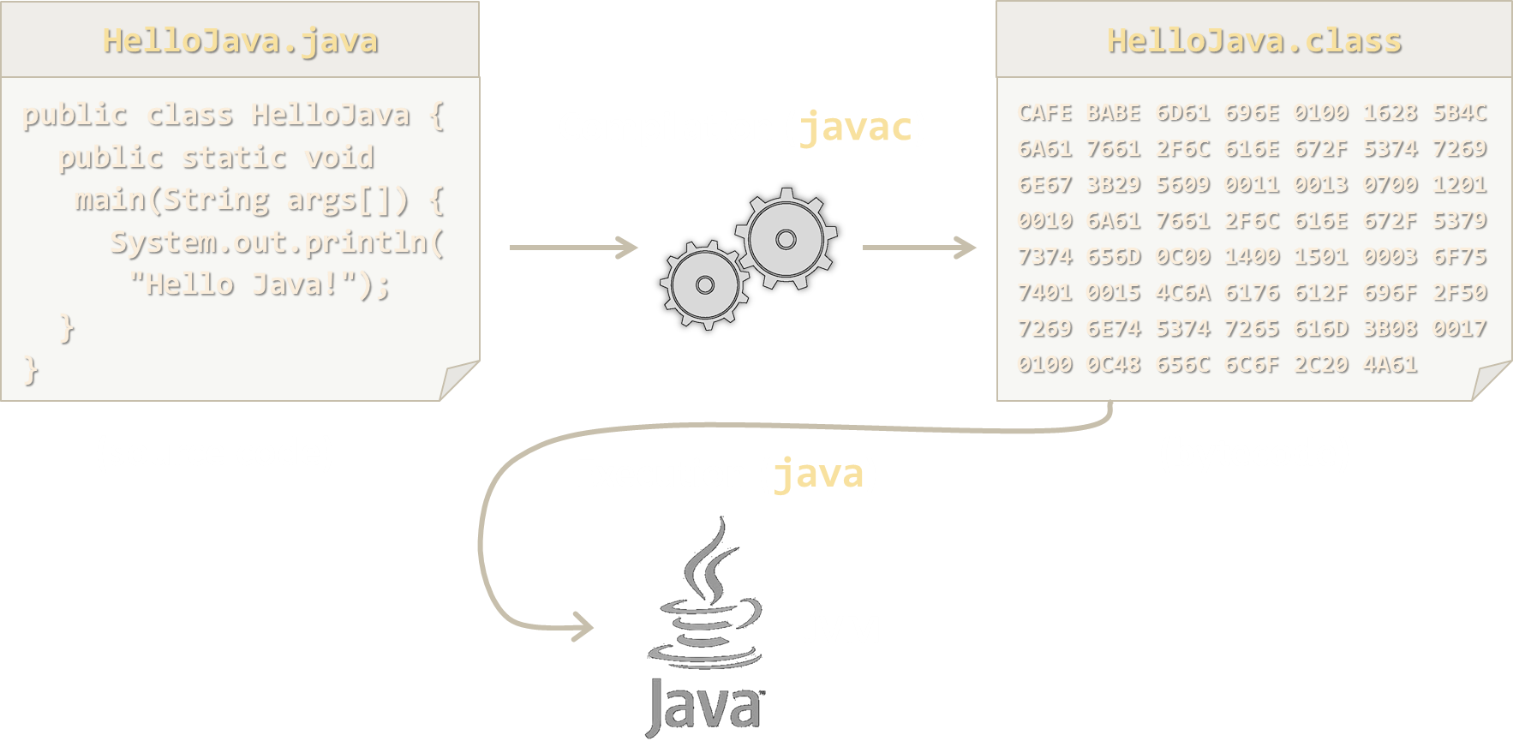
Console-Based Compilation and Execution of Java Code
Live Demo (in Linux and Windows)

Slide 23
Java Platform Editions
Java SE (Java Standard Edition)
For standalone Java applications and Java applets
Java EE (Java Enterprise Edition)
For server-side, enterprise, Web applications and Web services
A set of APIs and server specifications built on top of Java SE
Java ME (Java Micro Edition)
A pared down version of Java SE and API’s for embedded devices
Android
Android is Java-like platform for Android tablets and smartphones

Slide 24
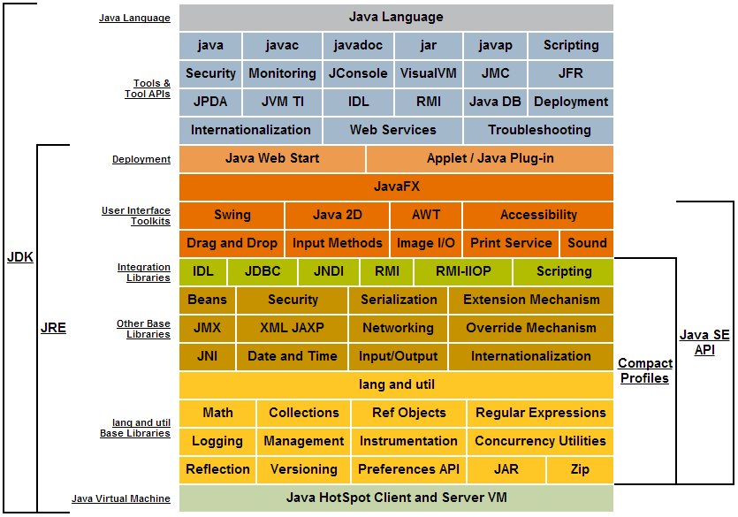
Java SE 8 Platform
* Learn more at http://docs.oracle.com/javase/8/docs/index.html

Slide 25
Packages in Java
In Java the classes usually stay in packages (like namespaces in C#)
A package holds a set of classes and other (inner) packages
Packages are included by "import package.subpackage.*"
Project directory structure always follows the package structure
src/org/softuni/main/Main.java
src/org/softuni/data/Student.java
package org.softuni.main;
import org.softuni.data;
public class Main { … }
package org.softuni.data;
public class Student { … }

Slide 26
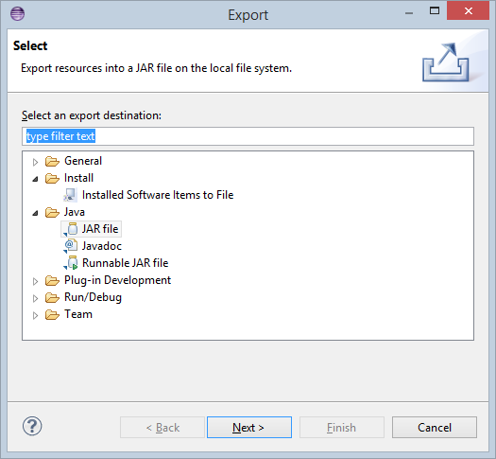
Creating a JAR File
A JAR file holds a set of classes and resources
Folders follow the package structure of the classes
JAR files are ZIP archives
Created by Eclipse or by a console tool called "jar"
jar -cf archive.jar <files>

Slide 27
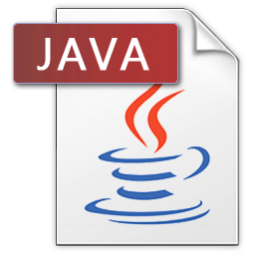
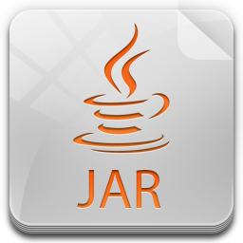
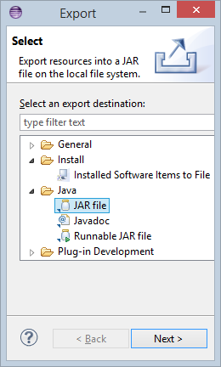
Creating a JAR File and Configuring the Classpath
Live Demo

Slide 28



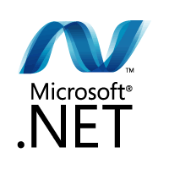
What You Need to Program?
A programming language
Java, C#, PHP, Python, …
Task to solve: project description
Development platform: IDE, compilers, SDK
IDE (Eclipse, NetBeans, Visual Studio), Java SDK, Android SDK
Set of standard classes (class library)
Java API classes / .NET API classes / PHP standard functions
Help documentation
Java API documentation / .NET API documentation

Slide 29
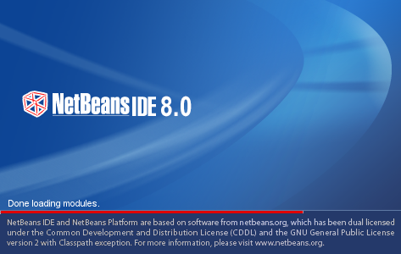
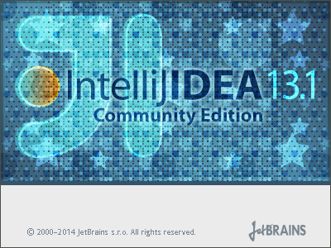
Java IDEs
Eclipse, NetBeans, IntelliJ IDEA

Slide 30
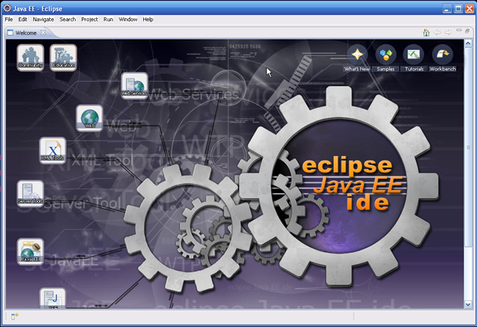
Eclipse – IDE for Java Developers
Eclipse is popular IDE (Integrated Development Environment)
For many languages: Java, PHP, Python, JavaScript, HTML, CSS, …
Eclipse is IDE that helps us to:
Write code
Design user interface
Compile code
Execute / test / debug code
Browse the help
Manage project's files

Slide 31
Benefits of Eclipse
Eclipse is a single tool for:
Writing code in many languages (Java, PHP, C++, JavaScript…)
Using different technologies (Web, mobile, embedded, …)
Complete integration of most development activities
Coding, compiling, running, testing, debugging, UI design, deployment, version control, ...
Free and open-source – www.eclipse.org
Easy to use and intuitive

Slide 32
Eclipse IDE
Creating, Compiling, Running and Debugging Java Programs – Live Demo

Slide 33
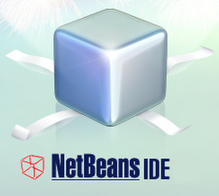
NetBeans
NetBeans is an open-source IDE for Java developers
Supports Java, C++, PHP, HTML5
Developed by Oracle (formerly by Sun Microsystems)
Written in Java, runs on Windows, Linux, Mac OS X
Supports the latest Java SE and Java EE technologies
Integrated features: code editor, debugger, profiler, GUI editor, source control tools, etc.
www.netbeans.org

Slide 34
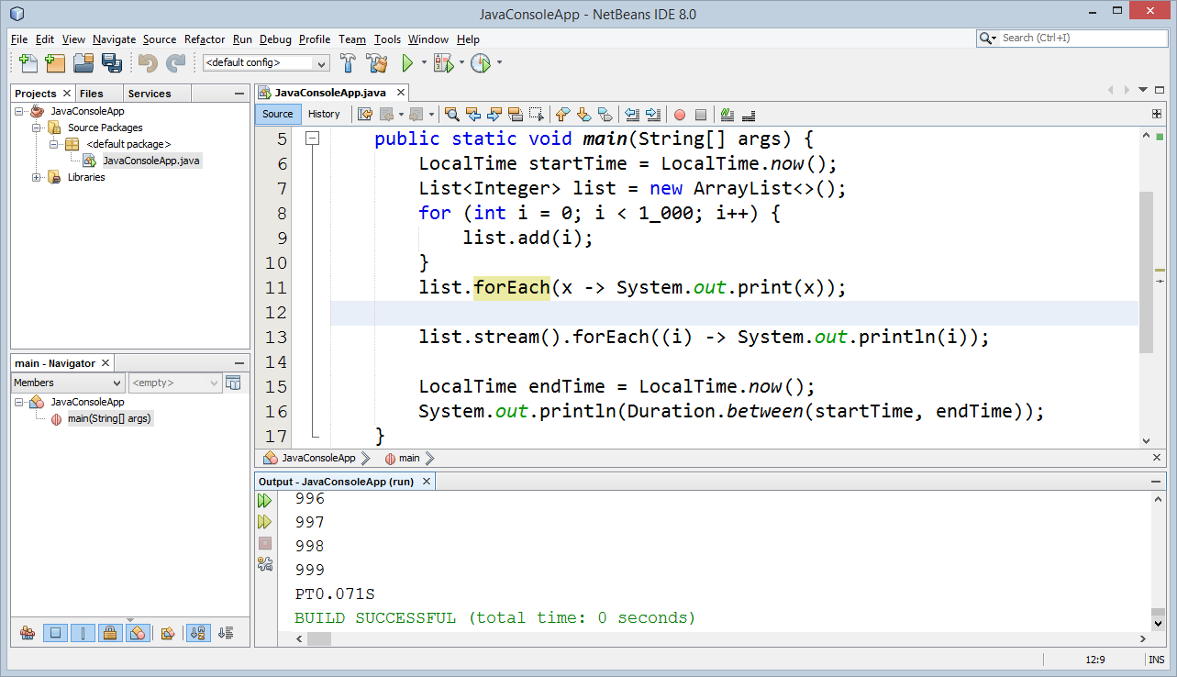
NetBeans
Live Demo

Slide 35

IntelliJ IDEA
IntelliJ IDEA is а powerful IDE for Java developers
Very good usability, helps you a lot with writing code
Supports Java, PHP, Python, Ruby, HTML5, SQL
The free edition support only Java and basic features
Advanced features, PHP, Python, Ruby, SQL, Java EE, Android, etc. are commercial
Written in Java, runs on Windows, Linux, Mac OS X
http://www.jetbrains.com/idea/

Slide 36
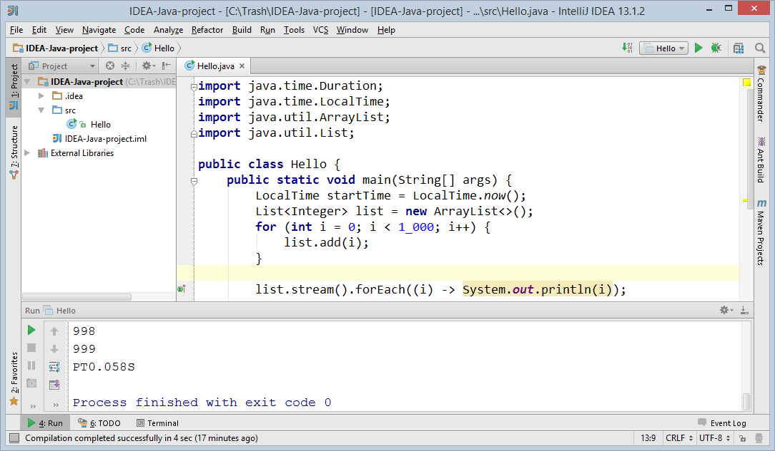
IntelliJ IDEA
Live Demo

Slide 37
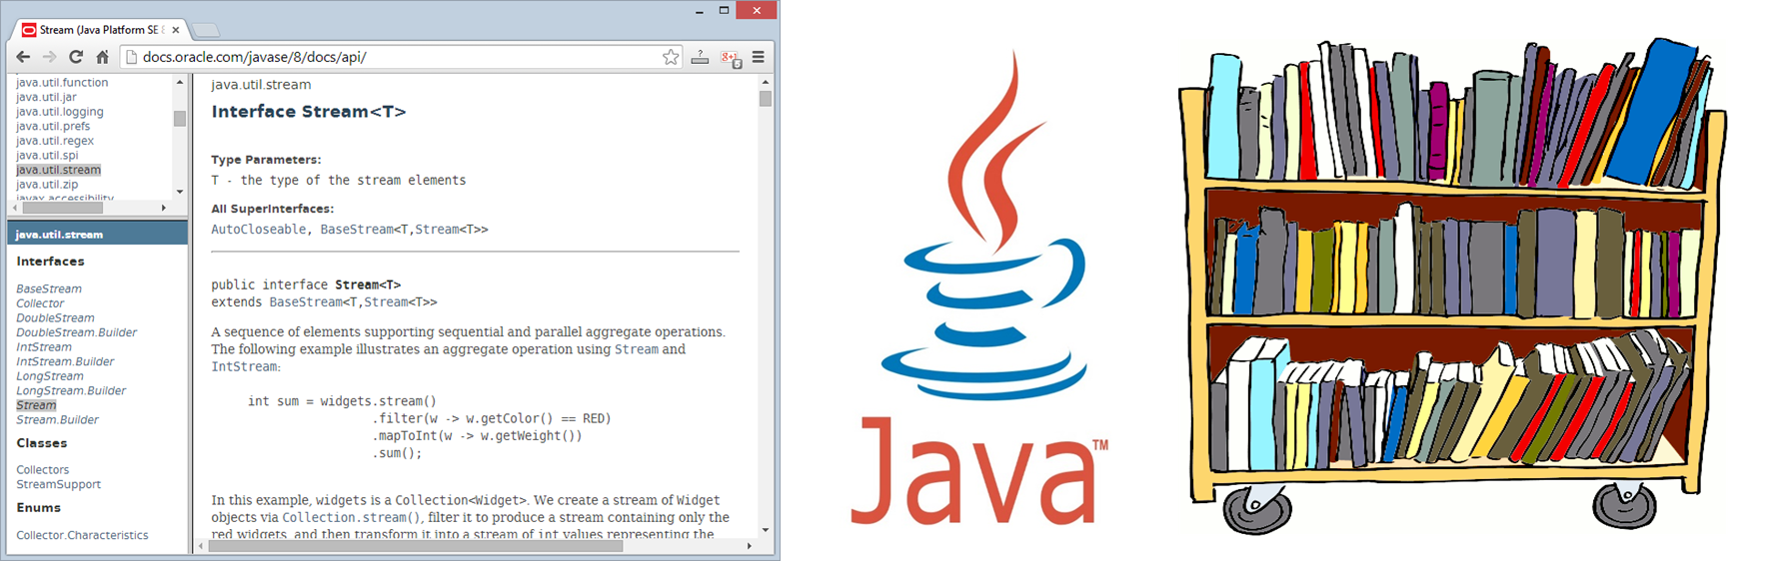
Java Documentation

Slide 38
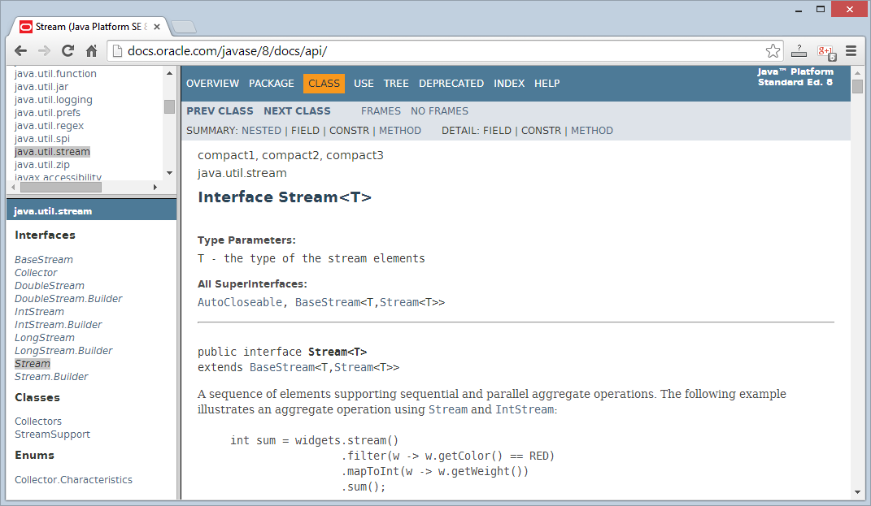
Java Documentation
Java 8 API Documentation
http://docs.oracle.com/javase/8/docs/api/
Complete documentation of all classes and their functionality
With descriptions of all methods, properties, events, etc.
Java 8 official documentation:
http://docs.oracle.com/javase/8/docs/
The Java Tutorial
http://docs.oracle.com/javase/tutorial/

Slide 39
Java API Documentation
Live Demo

Slide 40
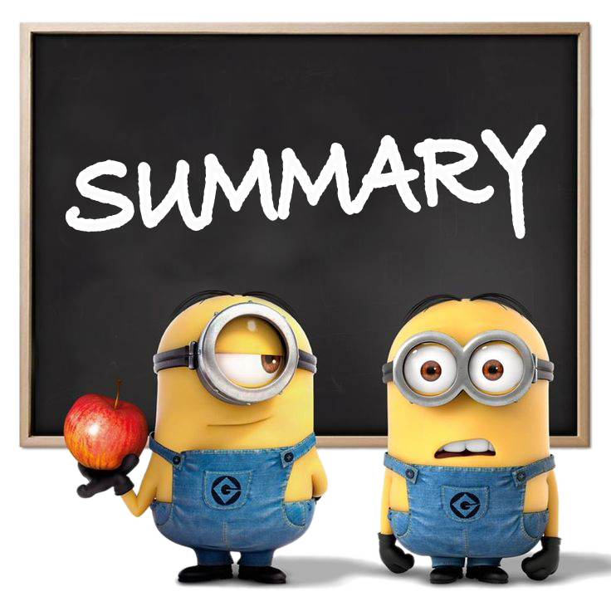
Summary
The Java platform consists of
The Java language
Java Virtual Machine
Java API classes
One Java platform, several editions
Java SE, Java EE, Java ME, Android
JDK = JRE + compilers and tools
Eclipse – powerful open-source Java IDE

Slide 41
Introduction to Java
https://softuni.bg/courses/java-basics/

Slide 42
License
This course (slides, examples, demos, videos, homework, etc.) is licensed under the "Creative Commons Attribution-NonCommercial-ShareAlike 4.0 International" license
Attribution: this work may contain portions from
"Fundamentals of Computer Programming with Java" book by Svetlin Nakov & Co. under CC-BY-SA license
"C# Basics" course by Software University under CC-BY-NC-SA license

Slide 43





Free Trainings @ Software University
Software University Foundation – softuni.org
Software University – High-Quality Education, Profession and Job for Software Developers
softuni.bg
Software University @ Facebook
facebook.com/SoftwareUniversity
Software University @ YouTube
youtube.com/SoftwareUniversity
Software University Forums – forum.softuni.bg

